Slide 1
Classic solitaire Game
Spring 2020 – CS400 – X-Team 245
Gabriel Wilkinson, Nada Elkordi, Haozhan Yuan, Russell Cheng

Slide 2
Problem description
Solitaire is a well-known and loved card game, unique in that it is played by a single player
This program seeks to model a solitaire game using a series of classes to model piles of cards
This version of solitaire uses the well-established rules of the game, but is novel in its management of the cards as objects

Slide 3
Solitaire Rules
The objective of solitaire is to build four piles of cards, one for each suit (hearts, diamonds, spades and clubs)
Each one of these piles should begin with the card with the lowest rank (the ace), with cards being added in ascending order
The player selects cards from seven face-down piles in order to pursue this objective, as well as from the ‘hand’, which is comprised of the cards not contained in these face-down piles
In our program, the sorted piles are called foundations, the seven face-down piles are the tableau, the remaining cards are the hand, and the waste pile holds cards that cannot be placed in any of these piles

Slide 4
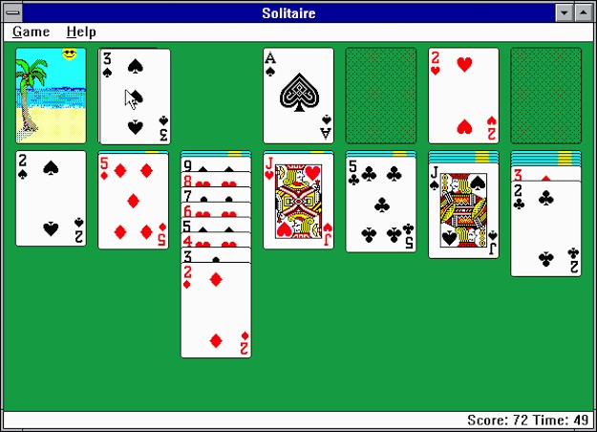
Graphical user interface sample
Hand pile
Waste
pile
Foundations: 4 piles
Tableau: 7
c
olumns

Slide 5
Class: Card
Each card will be represented as an object of class Card
This class contains variables representing the card dimensions, suit, color, rank, and its location in the gameplay space
The game will load 52 images; one for the face of each card and one for an overturned card (as well as images for the gameplay space)
The Card class contains methods isFaceUp(), getRank(), getSuit(), flip(), getColor(), and draw()
The card suit, rank, and color are represented by fixed enum variables:
Suit: Heart, Spade, Diamond, Club
Rank: King, Queen, Jack, 10, 9, 8, 7, 6, 5, 4, 3, 2, 1 (Ace)
Color: Red or Black

Slide 6
Class: Pile
Each group of cards is represented as an object of class Pile, which implements the Stack ADT, overriding its methods
PileNode is an inner class used to represented a node in a linked list, which comprises the Pile
The following classes extend the Pile class:
FoundationPile – represents a foundation pile of cards; a complete pile is built in ascending order of cards of the same suit
WastePile – represents the waste pile. Has one method, moveAllToHandPile(), to move all cards from the waste pile to the Handpile
Handpile – represents the hand pile; contains methods to draw a card and check if it can be moved to a foundation pile
Tableau – seven instances of this class represent the seven initial piles of cards to which the player may utilize to build the foundation piles

Slide 7
Class: SolitaireGame
The class SolitaireGame represents an instantiation of the game itself, and includes the main method.
SolitaireGame includes instances of the HandPile and WastePile classes, as well as array representing the four FoundationPiles and the seven Tableau instances
This class contains methods draw(), which initializes the game, and reset(), which reinitializes the game
SolitaireGame’s main method calls draw() to initialize the game and handles user input to proceed with gameplay

Slide 8
UML Class Diagram
SolitaireGame
WastePile
FoundationPile (array)
TableauPile (array)
HandPile
----------
reset()
draw()
Pile
head
count
----------
draw()
top()
pop()
isEmpty()
size()
peek()
add()
Card
rank
color
suit
width (static)
height (static)
faceup (Boolean)
xlocation
ylocation
----------
faceUp()
getRank()
getSuit()
flip()
getColor()
draw()
PileNode
card
next
----------
getNext()
FoundationPile
suit
----------
WastePile
----------
moveAllToHandPile()
HandPile
----------
checkAddFoundation()
TableauPile
----------
add()

Slide 9
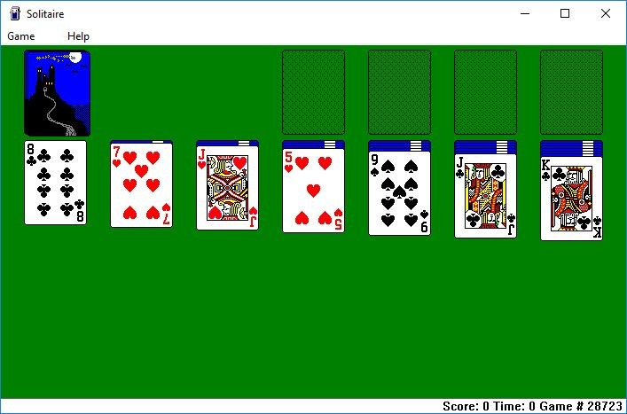
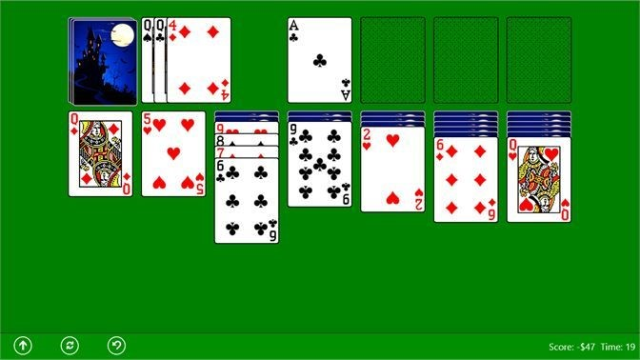
Input data format
Graphics represent the gameplay space
Mouse ‘clicks’ serve as input

Slide 10
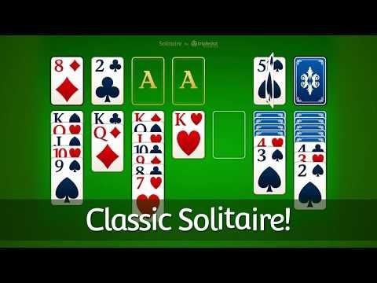
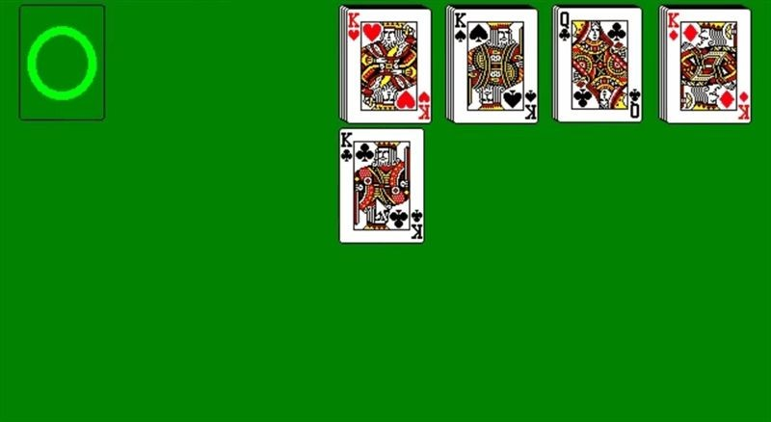
Output example
Every valid ‘click’ results in a change in the graphics representing the gameplay space
Game progress is checked for a win or loss

Slide 11
Project Milestones
Milestone 1 – Initialize the GUI class (taken from a GUI library) to draw the SolitaireGame window
Milestone 2 – Implement Card and Pile classes
Implement FoundationPile, WastePile, HandPile, and Tableau classes
Milestone 3 – Implement the SolitaireGame class to construct the game itself
Milestone 4 – Implement events such as user inputs (mouse input), and GUI changes which respond to these inputs
Milestone 5 – Implement win/loss messages as a result of the game’s conclusion, finalize testing
Assignment of Tasks:
Russell Cheng (Milestone 1)
Gabriel Wilkinson (Milestone 3)
Nada Elkordi (Milestone 2 + 5)
Haozhan Yuan (Milestone 4)

Slide 12
Additional information
https://github.com/Haozhan-Yuan/Xteam245
Above is a link to a GitHub repository containing additional information and files related to this project proposal
https://docs.google.com/document/d/10CO6Y5R1mWlRv4yu2kruK74elzMOZG9ux0AGneTGvhk/edit?usp=sharing
Above is a link to a Google Doc in PDF form which details the proposal

